Slide 1
Python Project on E-Commerce User behavior analysis
Submitted by
Amrut Kumar Behera
Reg: 12309979
Roll No: 41
Section: D2339​

Slide 2
introduction
In the rapidly evolving landscape of e-commerce, understanding user behavior has become paramount for businesses aiming to enhance customer experiences and optimize their operations. This Python project delves into the intricate patterns of user interactions within the e-commerce domain, with a specific focus on analyzing the Flipkart dataset. Flipkart, being one of the leading e-commerce platforms, provides a rich source of data that can be leveraged to gain valuable insights into customer preferences, purchasing trends, and overall engagement.

Slide 3
Project objectives
The primary objectives of this project are:
User Journey Mapping: Explore and visualize the typical user journey on Flipkart, from product exploration to purchase, in order to identify common pathways and potential bottlenecks.
Product Affinity Analysis: Analyze the associations between products frequently bought together, enabling the recommendation of complementary items to users during their shopping experience.
User Segmentation: Classify users into segments based on their behavior, allowing for targeted marketing strategies and personalized recommendations.
Predictive Modeling: Develop predictive models to anticipate user actions, such as predicting the likelihood of a user making a purchase based on their past behavior and preferences.

Slide 4
OUTPUT OF MY PROJECT
The insights derived from this analysis hold significant implications for both e-commerce platforms and consumers. For businesses, a deeper understanding of user behavior can inform strategic decisions, improve customer engagement, and drive revenue growth. On the consumer side, personalized recommendations and a more seamless shopping experience can enhance satisfaction and loyalty.

Slide 5
METHODOLOGY
The project employs Python programming language and utilizes various data analysis and machine learning libraries, such as pandas, NumPy, and Matplotlib.
The Flipkart dataset, a comprehensive collection of user interactions and transactions, serves as the cornerstone for the analysis.
Through this project, we aim to contribute valuable knowledge to the e-commerce community, shedding light on the dynamics of user behavior in the digital marketplace.

Slide 6
DATASET
This is the dataset which I have used for my analysis purpose.
https://www.kaggle.com/datasets/PromptCloudHQ/flipkart-products
Basically my dataset contains different product names which has been bought by different users.

Slide 7
Uses of panda lib in python
The pandas library in Python is a powerful and widely used library for data manipulation and analysis. It provides data structures for efficiently storing large datasets and tools for working with structured data seamlessly. Here are some common uses of the pandas library:
Data Reading and Writing:
pd.read_csv(), pd.read_excel(), pd.read_sql(): Import data from various file formats (CSV, Excel, SQL, etc.) into a pandas DataFrame.
DataFrame.to_csv(), DataFrame.to_excel(), DataFrame.to_sql(): Export DataFrame data to different file formats.
Data Exploration and Inspection:
DataFrame.head(), DataFrame.tail(): Display the first or last few rows of a DataFrame.
DataFrame.info(), DataFrame.describe(): Provide information about the DataFrame, including data types, non-null values, and summary statistics.
Data Selection and Indexing:
DataFrame['column_name'], DataFrame[['column1', 'column2']]: Select specific columns from a DataFrame.
DataFrame.iloc[], DataFrame.loc[]: Access data by index or label-based indexing.
Data Cleaning:
DataFrame.dropna(), DataFrame.fillna(): Handle missing values by dropping or filling them.
DataFrame.drop_duplicates(): Remove duplicate rows from a DataFrame

Slide 8
Data Filtering and Querying:
DataFrame[df['column'] > value]: Filter rows based on conditions.
DataFrame.query('condition'): Use SQL-like queries to filter data.
Data Aggregation and Grouping:
DataFrame.groupby(), DataFrame.agg(): Group data based on one or more columns and perform aggregation operations.
DataFrame.pivot_table(): Create pivot tables for more complex aggregations.
Data Manipulation:
DataFrame.apply(), DataFrame.applymap(): Apply functions to elements or columns of a DataFrame.
DataFrame.merge(), DataFrame.concat(): Combine multiple DataFrames.
Time Series Analysis:
pd.to_datetime(), DataFrame.resample(): Convert date strings to datetime objects and resample time series data.
Statistical Analysis:
DataFrame.corr(), DataFrame.cov(): Calculate correlation and covariance matrices.
DataFrame.mean(), DataFrame.median(): Compute mean, median, and other statistical measures.
Visualization:
DataFrame.plot(): Create basic plots directly from DataFrames.
pd.plotting.scatter_matrix(), pd.plotting.boxplot(): Generate more complex visualizations.
Handling Categorical Data:
pd.get_dummies(): Convert categorical variables into dummy/indicator variables.
Merging and Joining:
pd.merge(), DataFrame.join(): Combine DataFrames based on common columns.
Handling Text Data:
Series.str.contains(), Series.str.extract(): Perform text-based operations on string data.
The pandas library is an essential tool for data scientists and analysts working with structured data in Python, providing a flexible and efficient framework for various data manipulation tasks.

Slide 9
Uses of matplotlib in python
Matplotlib is a popular Python library for creating static, animated, and interactive visualizations in a wide range of formats. It provides a flexible and comprehensive set of plotting tools that make it a go-to choice for data visualization. Here are some common uses of matplotlib:
Line Plots:
Purpose: Display trends over a continuous variable.
Function: plt.plot()
Scatter Plots:
Purpose: Show the relationship between two continuous variables.
Function: plt.scatter()
Bar Plots:
Purpose: Compare categories or show the distribution of a categorical variable.
Function: plt.bar(), plt.barh()
Histograms:
Purpose: Display the distribution of a single variable.
Function: plt.hist()
Box Plots:
Purpose: Visualize the distribution of a dataset and identify outliers.
Function: plt.boxplot()
Pie Charts:
Purpose: Show the proportion of each category in a dataset.
Function: plt.pie()

Slide 10
3D Plots:
Purpose: Display three-dimensional data.
Function: Axes3D.scatter(), Axes3D.plot_surface()
Error Bars:
Purpose: Indicate uncertainty or variability in data points.
Function: plt.errorbar()
Annotations and Text:
Purpose: Add labels, text, and annotations to enhance plot readability.
Function: plt.text(), plt.annotate()
Subplots:
Purpose: Create multiple plots within the same figure.
Function: plt.subplot(), plt.subplots()
Customizing Plots:
Purpose: Adjust plot appearance, style, and formatting.
Function: plt.title(), plt.xlabel(), plt.ylabel(), plt.legend()
Saving Figures:
Purpose: Save the created plots in various formats (e.g., PNG, PDF, SVG).
Function: plt.savefig()
Interactive Plots:
Purpose: Create interactive visualizations for exploration.
Function: plt.show() (with interactive backends like %matplotlib notebook)
These are just a few examples of the many functionalities provided by matplotlib. It is a versatile library that is widely used in fields such as data science, machine learning, finance, and scientific research for effective data visualization and communication.

Slide 11
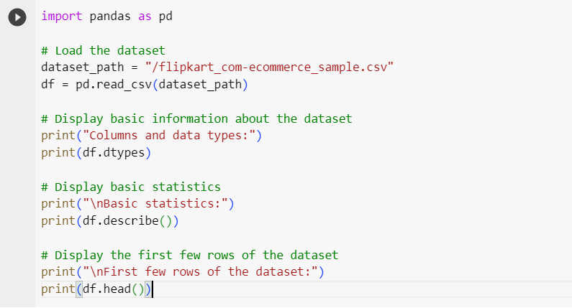

Slide 12
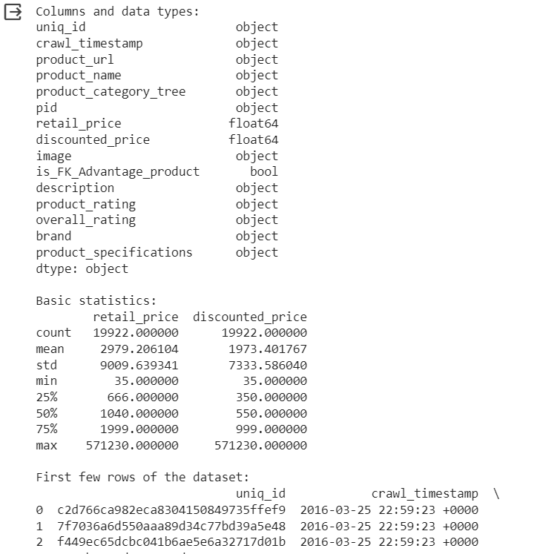
OUTPUT

Slide 13
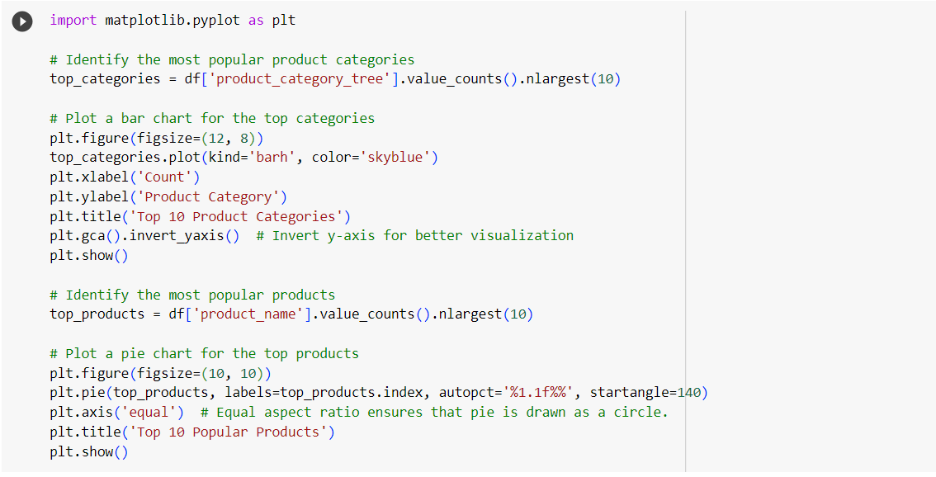

Slide 14
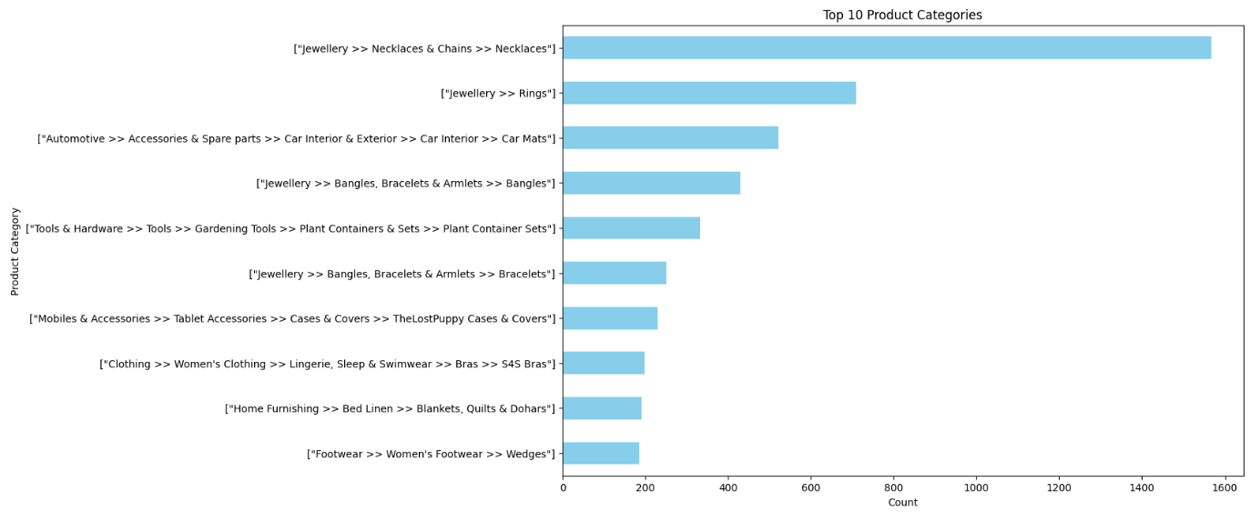
OUTPUT

Slide 15
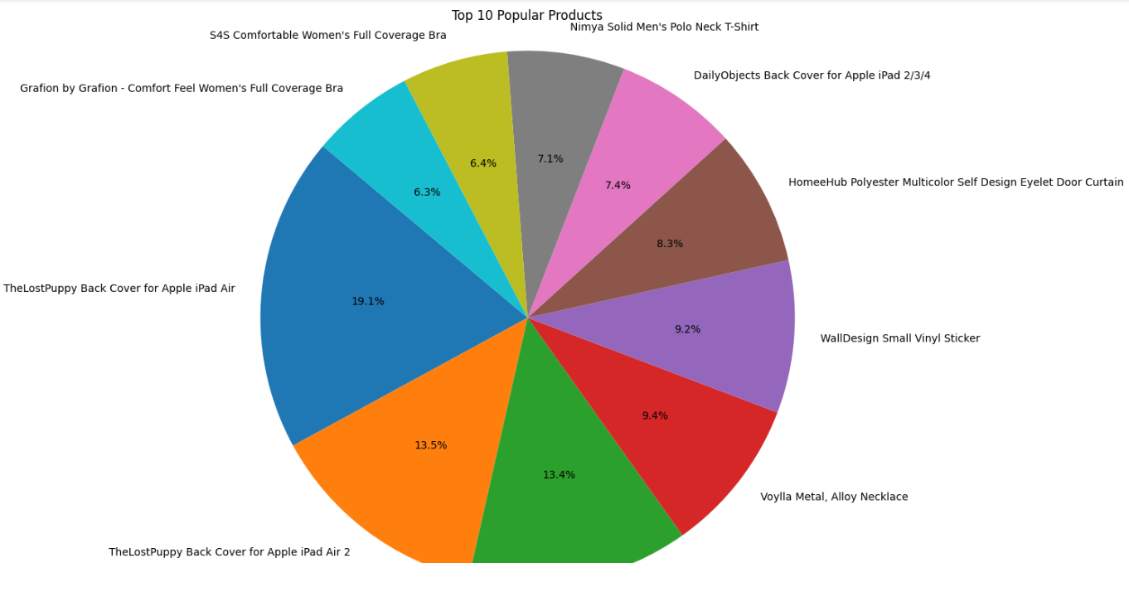
OUTPUT

Slide 16
THANK YOU
Amrut Kumar Behera
amrutkumar90@gmail.com

